Slide 1


Olist E-Commerce
Sales & Delivery Analytics
From raw e-commerce data to a decition-ready Power BI dashboard - total revenue, delivery perfomance and geografy of sales, 2017-2018.
Data source
Kaggle Brazilian E-Commerce Public Dataset by Olist
Reporter: Serhiy Dranko
Date: 14.08.2026
Repository
https://github.com/serhiy-dranko/olist-e-commerce-dataset

Slide 2
PROJECT OVERVIEW
What the dataset covers, and what we set out to build
Olist is a Brazilian marketplace connecting small merchants to major retail channels. Its public dataset traces real, anonymized orders from purchase to delivery to customer review.
Project sources
Kaggle Dataset :
The goal: turn 9 raw relational tables into a single analytical model that answers concrete revenue, logistics, and geographic questions.
Then surface them in an interactive Power BI dashboard.
Pipeline & SQL Repository
https://github.com/serhiy-dranko/olist-e-commerce-dataset
100 K+
27
4.05
Delivery tool
Power BI Desktop: data model + interactive report.
Orders, 2017-2018
Product categories
Avg review score
Source: Brazilian E-Commerce Public Dataset by Olist, January 2017 - August 2018 · Imported at 10.08.2026 12:49:00

Slide 3
FRAMING THE ANALYSIS
Three business questions the dashboard answers
1
Revenue trend by category
Is revenue growing or shrinking, and which categories drive it?
2
Delivery time vs. review score
Do late/slow deliveries correlate with lower review scores?
3
State-level performance
Where is the business strong or weak geographically?
Source: Brazilian E-Commerce Public Dataset by Olist, January 2017 - August 2018 · Imported at 10.08.2026 12:49:00

Slide 4
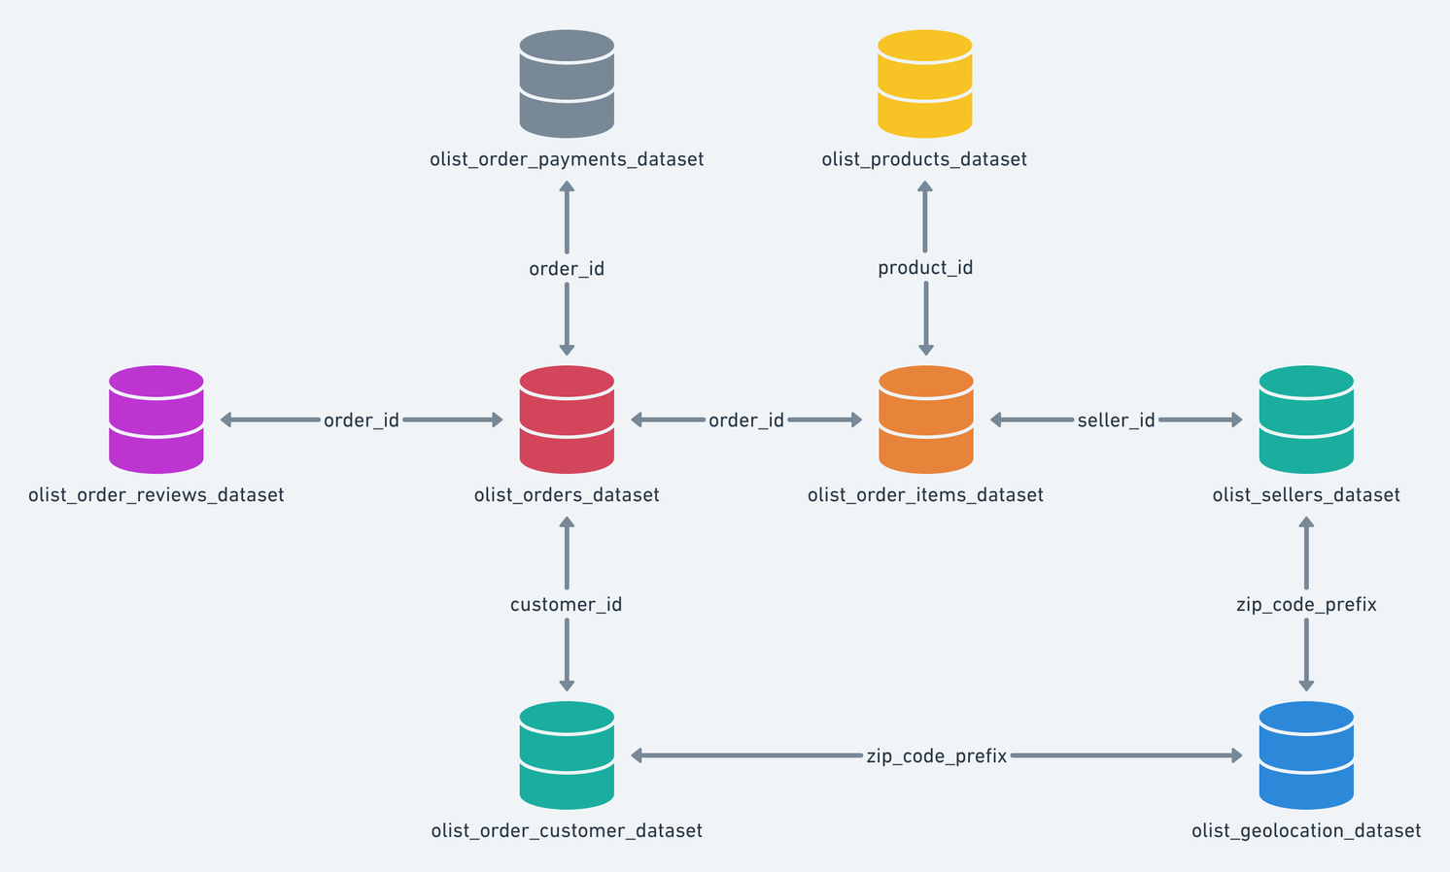
FROM QUESTION TO QUERY
Data schema: tables & columns behind each question
Revenue by category
TABLES
orders · order_items · products ·
product_category_name_translation
COLUMNS
order_purchase_timestamp, price,
product_id → product_category_name
→ product_category_name_english
Delivery time vs. review
TABLES
orders · order_reviews
COLUMNS
order_purchase_timestamp,
order_delivered_customer_date,
order_estimated_delivery_date
→ review_score
State-level performance
TABLES
orders · customers · order_reviews
COLUMNS
customer_id → customer_state,
order_id → review_score
Source: Brazilian E-Commerce Public Dataset by Olist, January 2017 - August 2018 · Imported at 10.08.2026 12:49:00

Slide 5
HOW THE PIPELINE IS BUILT
From 9 CSV files to a queryable semantic model
1
Extract
2
Transform
3
Model
4
Serve
9 raw Kaggle CSVs
(orders, items, customers, products, payments, reviews, sellers, geolocation, category translation) loaded as source tables.
Power Query / SQL:
Type casting,
de-duplication, key cleanup and calculated fields: delivery_time_days, state_grouped, pCat_grouped.
Tables joined into a main- table:
A wide detail table (main_sales_orders_detail) plus lookup dimensions (states, category translation).
DAX measures
Total Revenue, Order Count, Avg Review Score.
Builded in the interactive Power BI report and slicers.
Source: Brazilian E-Commerce Public Dataset by Olist, January 2017 - August 2018 · Imported at 10.08.2026 12:49:00

Slide 6
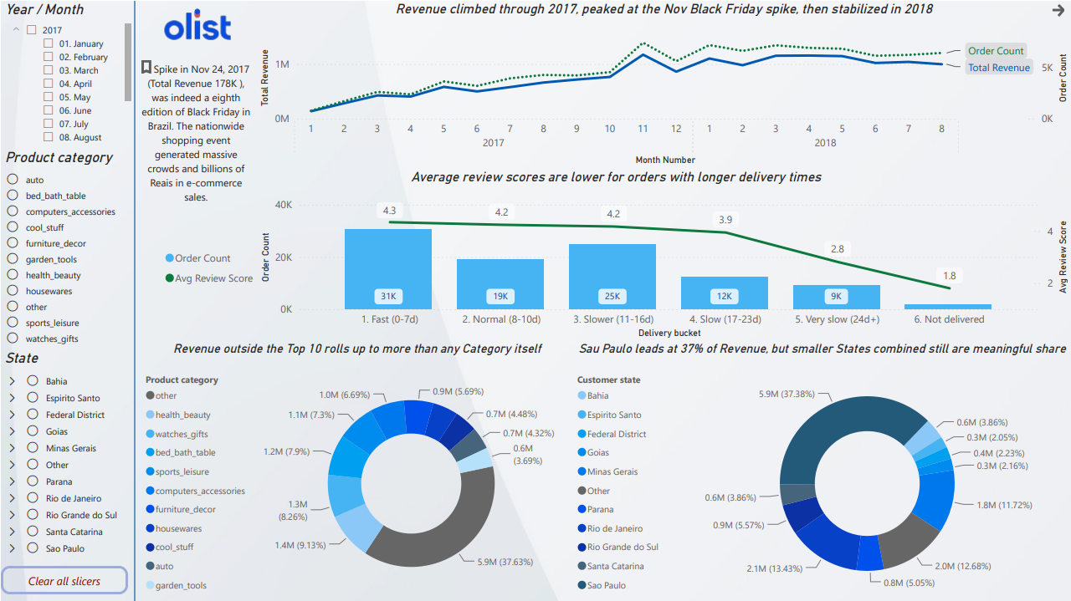
DASHBOARD OUTPUT
What the data shows
Revenue grew, then plateaued
Monthly revenue climbed through 2017, spiked to R$178K on the Nov 24, 2017 Black Friday, then stabilized around R$1M/month through mid-2018.
Slower delivery → lower reviews
Avg. review score falls from 4.33 (0–7 day delivery) to 1.80 for undelivered orders. It’s a clear, near-linear relationship.
Sao Paulo dominates, but the tail matters
Sao Paulo alone drives 37% of revenue. The next 9 an Othe combined states combined still contribute the majority of the remainder.
Source: Brazilian E-Commerce Public Dataset by Olist, January 2017 - August 2018 · Imported at 10.08.2026 12:49:00

Slide 7
Thank you for your attention!
I will be happy to answer your questions.
Source: Brazilian E-Commerce Public Dataset by Olist, January 2017 - August 2018 · Imported at 10.08.2026 12:49:00

